Slide 1
Scientific Research in Information Systems
Chapter 4
THEORISING
JAN RECKER

Slide 2
Overview
Theorising
What Is Theory?
Definition of Theory
Importance of Theory
Building Blocks of Theory
Types of Theory
Theorising as a Process
An Example
Practical Suggestions to Theorising
Further Reading

Slide 3
Definition of Theory
Theories are proposed explanations of empirical natural or social phenomena, constructed in a way consistent with the scientific method.
Theory is a system of constructs and relationships between those constructs that collectively present a logical, systematic, and coherent explanation of a phenomenon of interest.
Theory is NOT:
Data
Idiographic
Description or prediction only
Design
Self-perpetuating
Universal
Notes:
We stated that scientific knowledge is our collection of theories built, derived, and tested using the scientific method.
We also stated that theories represent our current suggested explanations for what our world looks like and how things in it behave and function.
-Theory is not data: sets of evidence, observations, or arguments do not make up theory.
-Theory is not idiographic: an explanation of a single situation or phenomenon, in whatever detail, is not theory, as it does not allow for generalising to other situations, events, or phenomena.
-Theory is not description or prediction only: a mere description or classification of phenomena or other observations does not constitute theory because such
descriptions (taxonomies, typologies, classifications and so forth) still operate at the empirical, observational level.
-Theory is not design: The construction of an artefact, however novel and useful it may be, in itself is not theory.
-Theory is not self-perpetuating: Theory is not and should not be an activity that is an end in itself, meaning that it would be important to you not because it will
help you to achieve something, but only on the premise that you think that it is important.
-Theory is not universal: Until
that golden nugget of research is found, theories, while striving for comprehensiveness, have their share of limitations in the form of leading assumptions and
boundary conditions, which specify the limits to which the theory is held; for example, theories that pertain to large and complex organisations only, rather
than all types of organizations.

Slide 4
Importance of Theory
Theories are at the core of any research process.
Theories are important to the planning process in research:
Provide guidance in terms of where to direct the attention of this or future study.
Serve as a framework where current, past, as well as future empirical work can be incorporated.
Can be the material that integrates sets of individual studies into a larger research program.
Theories also have plenty to offer to the execution process in research:
Provide a framework for synthesizing, analyzing, and integrating empirical findings and observations.
Help us analyze empirical data and observations by identifying patterns and themes in the data.
Provide suggestions that can be used to explain the findings or observations and to make sense of the data collected.
The key basis for the derivation of hypotheses that can be examined in empirical work.

Slide 5
Building Blocks of Theory
Common structural components across all theory
4 Building Blocks
What (constructs)
How (relationships)
Why (justifications)
Who, Where, When (boundary conditions)
Notes:
Note: A discipline that concerns information technology in use by [individuals/organisations/ economies/other groups of people], by definition, is a part of the social sciences. (As soon as our investigation concerns a human element, imprecision, vagueness and ambiguity creeps into our research.)

Slide 6
First Building Block of Theory: What (Constructs)
Which constructs compose a theory is a fundamental question.
The choice of constructs determines both locus (the domain addressed) and focus (the level of abstraction) of the theory.
The number of constructs determines comprehensiveness (how much does the theory account for?) as well as parsimony (what is the most simple account possible?).
Two key ways in which way we can contribute to theory:
We can articulate new constructs as the basis for new theory.
We can delete constructs from a theory in an attempt to increase parsimony of the account offered by theory.
Constructs can be specified further in terms of their status to the theory:
Focal constructs
Ancillary constructs
Notes:
A construct is the creation of an operationalisation of a concept in a way that we can define it in terms of how we can measure the construct.
Focus constructs are those that are the key components in our theory and determine its locus and focus.
Ancillary: There might be further constructs that describe other phenomena or properties of interest and that are associated with the focal constructs in some way perhaps because they moderate or mediate some effects of some constructs on another construct.

Slide 7
Second Building Block of Theory: How (Relationships)
How the constructs are related to another is a key question.
We are describing laws of interactions: patterns of how values of a construct change in accordance with the change of values in another construct.
The nature of the specified relationship depends on the purpose of the theory and may be of many types such as:
Associative
Compositional
Unidirectional
Bidirectional
Conditional
Causal

Slide 8
Second Building Block of Theory: How (Relationships) (Cont.)
We can contribute to theory with a focus on the relationships between constructs:
We can articulate new laws of interaction amongst existing or new constructs.
We can delete laws of interactions amongst the constructs of a theory.
We can re-define the existing laws of interaction amongst constructs in a different way.
The laws of interaction can be specified with varying levels of precision.
Notes:
In general, the laws of interaction can be specified with varying levels of precision. For instance, some theories merely state that the values of their constructs
are associated with one another by showing that high values of one construct are associated with high or low values of another construct, or the existence of one value of a construct signal the existence of a certain value of another construct. In some cases, the functional relationships between constructs can be specified more precisely as when a certain value range of one construct mediates, mitigates, or moderates the value range of another construct or even the relationships between two or more other constructs.

Slide 9
Third Building Block of Theory: Why (Justifications)
Two key questions:
Why are the chosen constructs relevant and complete?
Why are the laws of interactions as specified?
This part of theory relates to the so-called justificatory mechanisms
The justificatory mechanisms
Are the key vehicle to lending credence to the particular account that the theory offers
Describe the logic of the key assumptions underlying the theory
Provide the basis for gauging whether the proposed conceptualization is reasonable.

Slide 10
Third Building Block of Theory: Why (Justifications) (Cont.)
We can contribute to theory in at least two ways:
We can articulate new justificatory mechanisms for the constructs or relationships of a new or an existing theory.
We can delete a justificatory mechanism underlying a theory by showing that the assumptions are violated.

Slide 11
Fourth Building Block of Theory: Who, Where, When (Boundary Conditions)
Boundary conditions
Describe the circumstances under which the theory is expected to hold.
Describe the scope and limitation of a theory.
We can contribute to theory in at least two ways through a focus on boundary conditions:
We can articulate new conditions that specify where a theory will or will not hold.
We can examine our theory thoroughly in situations that violate some condition of the original theory to explore whether or not the theory will hold.

Slide 12
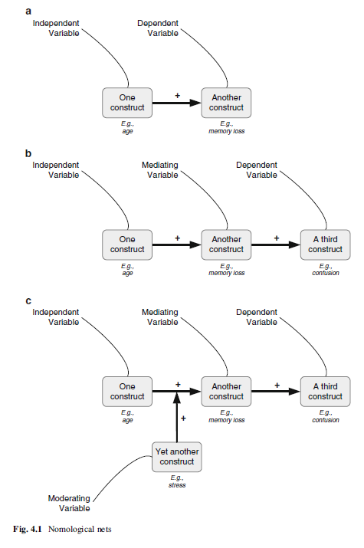
Nomological Nets
We can classify constructs as independent, dependent, mediating, or moderating variables. This classification of constructs is called a nomological net of constructs.

Slide 13
Types of Theory
Theory has one or more of the following four aims:
Analysis and description
Explanation
Prediction
Prescription

Slide 14
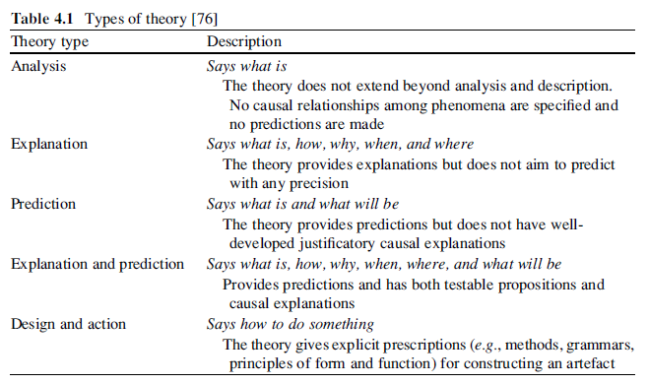
Types of Theory (Cont.)
Notes:
If we combine the aims in previous slide, we can then distinguish five general types of theory that pertain to information systems as a research discipline.
Analysis theories are the most basic type of theory; they describe “what is” by classifying specific dimensions or characteristics of phenomena such as individuals, groups, situations, or events.
Explanation theories focus primarily on describing how and why some phenomena occur.
Prediction theories aim at describing what will be without focusing on why that might be the case.
Explanation and prediction theories attempt to be able to predict as well as explain the underlying causal conditions that lead to a predicted outcome.
Design and action theories are theories that specify how to do something. These theories give normative, prescriptive rules such as principles of form and function, methods, and techniques together with justificatory theoretical knowledge about how to construct an artefact (for example, a specific type of an information system).

Slide 15
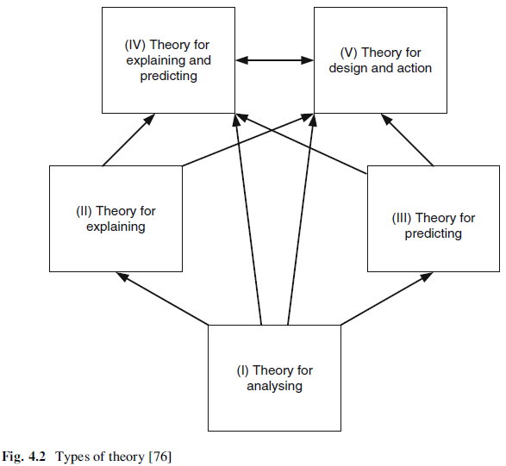
Types of Theory (Cont.)
Notes:
Having explained the types of theories, we should briefly discuss interrelationships, logically as well as temporally. Consider Fig. 4.2: analysis theories are required for the development of all other theories because they offer a descriptive account of relevant constructs and attributes for phenomena. Explanation theory as well as prediction theory can provide the basis for the development of theory through explanation and prediction. All the other theory types can inform design theory. Design theory and theory for explanation and prediction can be closely interrelated as the design can be informed by a thorough explanation of how a particular phenomenon works.

Slide 16
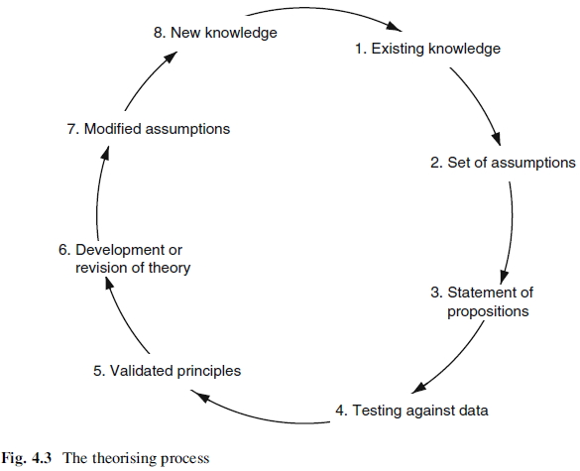
Theorising as a Process
Theorising is the application or development of theoretical arguments to make sense of a real account (an observed phenomenon).
Theorising is iterative and cyclic in nature.
Notes:
Theorising, starts with a set of knowledge (1.) and the assumptions (2.) we can derive from it. Note that I am not specifying what form or structure this knowledge should have. It may or may not be knowledge derived by the scientific method – in fact, it may depend on rigorous data analysis, creative thinking about some observations, inspiration, or simply good luck. Theorising then continues (3.) with formulating tentative propositions (or more formally, hypotheses; or less formally, conjectures) about the phenomenon we are theorizing about. This step can be inductive, deductive, or abductive in nature.
Theorising then should involve some sort of test of the propositions against data (4.). The outcome of this step is a set of general and validated principles (5.), that is, principles that have been confirmed through testing
the theory empirically. These may be the original principles that we speculated in our set of propositions or hypotheses, or they might be adjusted principles drawn from the data. In turn (6.), our theory can be fully developed (when the data confirmed the propositions) or revised (if the data showed that our propositions need to be adjusted). Based on theory we can then modify the set of assumptions by adding the theoretical premises developed to the list of assumptions (7.), and in turn create new knowledge (8.), which can form the set of existing knowledge for a new iteration of the theorising circle.

Slide 17
An Example
We start with observation
You’re in class, and the guy next to you – who is obviously a football player – says an unbelievably dumb thing in class. So you ask yourself: “Why?”
1st version: Football players are dumb. (Not very general, but very narrow)
2nd version: Athletes are dumb. (More general, But no sense of process and explanation)
3rd version: To be a good athlete requires lots of practice time; being smart in class also requires study time. Amount of time is limited, so practicing a sport means less studying which means being less smart in class (with explanatory process)
4th version: There is limited time in a day, so when a person engages in a very time-consuming activity, such as athletics, it takes away from other very time-consuming activities, such as studying (Limited Time Theory). (Using mechanism)
Notes:
Let’s start theorising about reasons for why the football player guys said an unbelievably dumb thing in class.

Slide 18
An Example (Cont.)
Theorising also involves moving forward and not only supporting our theory through data but also ruling out alternative theories.
The “Excellence Theory”: everyone has a need to excel in one area. Achieving excellence in any one area is enough to satisfy this need. Football players satisfy their need for accomplishment through football, so they are not motivated to be smart in class.
The “Jealousy Theory”: we are jealous of others’ success. When we are jealous, we subconsciously lower our evaluation of that person’s performance in other areas. So we think football players ask dumb questions.
Notes:
Through the same process as in previous slide, we may have ended up with different theories: The “Excellence Theory” and The “Jealousy Theory”.

Slide 19
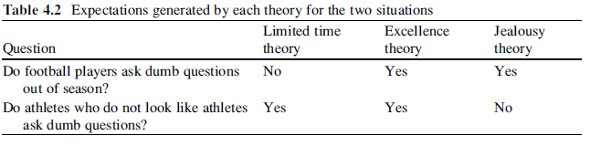
An Example (Cont.)
Notes:
What we have done is we conjured situations in which we have different expectations as per the propositions of our theory, and we conjured sufficient situations to determine a verdict about the theories (see Table 4.2).

Slide 20
Practical Suggestions to Thinking
Theories should be well argued.
Theorising should be insightful.
Theorising should challenge existing beliefs and offer a set of new beliefs.
Theorising should have (surprising) implications that make sense and are intuitively logical.
Don’t hide but instead focus on unique findings.
Use easy yet convincing examples.
Be aware of and familiar with reference theories
Iterate between theory and data

Slide 21
Practical Suggestions to Thinking (Cont.)
How do you know that you are finishing with theorising, that you have good theory?
You are on a good way if you have answer to the following questions:
Is your account insightful, challenging, perhaps surprising, and – importantly – does it seem to make sense?
Does it connect disconnected or disconnect connected phenomena in a new way?
Is your account (your arguments) testable (falsifiable)?
Do you have convincing evidence to support your account?
Is your account as parsimonious as it can be?
Are the arguments logical?
What can you say about the boundary conditions of the theory?
What are implications of your theory?

Slide 22
Further Reading
Gregor, S.: The nature of theory in information systems. MIS Q. 30, 611–642 (2006)
Dyer, W.G., Wilkins, A.L.: Better stories, not better constructs, to generate theory: A rejoinder to Eisenhardt. Acad. Manag. Rev. 16, 613–619 (1991)
Eisenhardt, K.M.: Building theories from case study research. Acad. Manag. Rev. 14, 532–550 (1989)
Eisenhardt, K.M.: Better stories and better constructs: The case for rigor and comparative logic. Acad. Manag. Rev. 16, 620–627 (1991)
Wacker, J.G.: A definition of theory: Research guidelines for different theory-building research methods in operations management. J. Oper. Manag. 16, 361–385 (1998)
Weber, R.: Editor’s comments: The problem of the problem. MIS Q. 27, iii–ix (2003)
Weber, R.: Editor’s comments: Theoretically speaking. MIS Q. 27, iii–xii (2003)
Weick, K.E.: Theory construction as disciplined imagination. Acad. Manag. Rev. 14,516–531 (1989)
Weick, K.E.: What theory is not, theorizing is. Adm. Sci. Q. 40, 385–390 (1995)
Whetten, D.A.: What constitutes a theoretical contribution? Acad. Manag. Rev. 14, 490–495 (1989)

Slide 23
Thank You
☺

